Slide 1
Scholarship Opens, Copyright Walks In Copyright Support for Open Multimodal Assignments
Maryam Fakouri, MLS, JD
Copyright Librarian
University of Washington Seattle
(she/her)

Slide 2
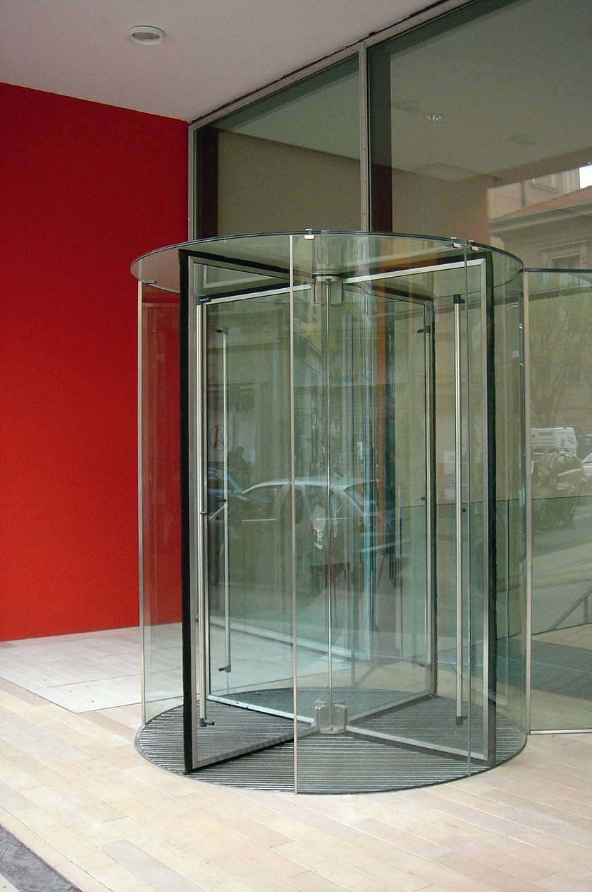
Agenda
Multimodal assignments – what and why?
Students as content users
Students as content creators
Contractual issues
Privacy
Your role
Discussion
Revolving Door Milano by Naoya Fujii is licensed under CC BY NC.

Slide 3
But first . . .
Nothing in this presentation is legal advice.
This will be a broad overview of many topics.
Notes:
Obligatory disclaimers
Nothing in this presentation is legal advice.
We’ll survey rights and related legal and ethical aspects of online multimodal assignments. This will not be a comprehensive exploration of any of the topics presented. I assume you are already familiar with ©, fair use, and the Creative Commons—we won’t go into detail about them.

Slide 4
Open door 1 by Dianne Collins is licensed under CC BY NC.
Notes:
The sign on this door says “Closed to the public.” But the door is open! Just like more and more scholarship is open.
Open doors are our theme today.

Slide 5
Multimodal Assignments
Multimodal assignments ask students to use more than one of the modalities (i.e., visual, audio, gestural, spatial or linguistic) to create meaning. – Baruch College, CUNY
Student work might result in an Open Educational Resource (OER). True OER allow remixing and adaptation.
Notes:
What are multimodal assignments?
They require students to use various modalities (ways of experiencing something / taking in information or expressing it) to create meaning. Students might use imagery, sound, text, or video footage. For example, students might deliberately juxtapose media to create new meanings or responses to text. Or they might record a video of themselves responding to course content using their own words and gestures.
Thinking back, you can probably recall different assignments you or young people in your life had that were multimodal. You just might not have called them that at the time.
At UW, we have an uptick in classes creating Open Educational Resources (OER) as class projects. Usually open books. Open books can be multimodal. But not all multimodal assignments are OER. To be clear, OER must be adaptable and reusable. Not all multimodal assignments allow adaptation and re-use. We’ll see this again soon.

Slide 6
Why multimodal assignments?
Students engage with course content differently.
Students are motivated when their work will be seen by the public.
Group assignments build collaboration skills.
Faculty learn alongside students.
Multimodal assignments may be more practical for remote teaching and learning.
Notes:
Text has been predominant mode in higher education. Students read. Students write.
Students engage with content differently when they use different modes. Inviting students to use visuals, sounds, time-based media broadens the conversation about a topic.
Students are motivated to do good work when they know it will be publicly accessible.
Multimodal assignments often have a group work aspect. This fosters collaboration skills and distributes the workload-like if the assignment is to create a video.
Faculty I’ve worked with are willing to experiment with new assignments. They are enjoyable to work with because they’re open minded, eager to learn alongside their students, and expand the possibilities of what they and their students can accomplish in one academic term! I find these classes dynamic and open.
Faculty may not want to spend valuable time on the details of copyright, but they recognize that they should address copyright. You can take that pressure off by providing a concise guest lecture!
*Next week’s webcast will be an in-depth case study by Kathy Salgado “Using a Multi-Modal Project to Teach Ethical and Legal Use of Information.”
I’ve heard that students divide into those who also embrace this way of working and those who do not. So that leaves you with an enthusiastic and open-minded group.
POLL 1: Have you noticed an increase in open, multimodal assignments during the Covid pandemic?

Slide 7
Select an example
Women’s studies book
Filipinx studies book
Economic sociology video (5:12)
Ballot initiative video (4:54)
Infographics of research findings
Consider
1. Did students use media they did not create?
2. How did the student authors identify themselves, if at all?
3. What platforms, if any, did the students use to share their projects?
Notes:
In the next 6 minutes, examine one of these examples of students’ multimodal work. Carla and I will give 2 and 1 minute warnings before we resume. Some of these examples are videos, and I’ve included their running times. As you explore, consider these questions:
1. Did students use content they did not create?
2. How did the students identify themselves, if at all?
3. What platforms, if any, did they use to share this content? For example, YouTube?
Put URLs of examples in chat.
Womens studies book
https://uw.pressbooks.pub/badasswomxninthepnw/front-matter/front-cover/
Critical Filipinx Studies book https://uw.pressbooks.pub/criticalfilipinxamericanhistories/
Economic Sociology video (undergraduate) https://www.youtube.com/watch?v=QB5JtUFWLKM
Ballot initiative video (graduate)
Infographics of research findings https://derekbruff.org/blogs/math216/?cat=24

Slide 8
Copyright
©
Reproduce a work
Create derivatives of a work
Distribute a work publicly
Perform a work publicly
Display a work publicly
Perform sound recordings publicly via digital audio transmissions
Notes:
Now it’s time to talk about aspects of ©, related laws, and ethical issues that might connect to open, multimodal assignments. As a reminder, © is a bundle of these exclusive rights.

Slide 9
Using © protected content in multimodal assignments
Color guard by drp I licensed under CC BY NC ND.
Notes:
POLL 2: How often do you speak with students and faculty about using © protected content?
When you tell people you talk to students about ©, their first thought might be that you are like a crossing guard, telling people it’s safe to proceed or, more likely, to stop. And, yes, we do offer information about risk, best practices, and compliance—safety related aspects of copyright.
Please tune in for Kathy Salgado’s presentation next week about her embedded work with a class.
Post link to chat: https://copyrightconference.lib.miamioh.edu/schedule/
I’m going to briefly mention some teaching opportunities here.

Slide 10
Decision Tree for Using Copyright-Protected Works
1. Is this something that © protects?
2. Is this work protected by ©?
If the work is by the federal government, no.
If the work is old enough to be in the public domain, no.
3. Does the work have a CC license that allows my use? If yes, use the work!
4. Is my use fair use?
Weigh all four factors of fair use:
Purpose
Nature of the work
Amount of work used
Effect on market of the work
Make a good faith determination. If I don’t believe my use is fair, I need permission.
5. Do I have a license for my use? If no:
Research © owner
Negotiate permission
Pay any fees
Keep records
6. If I have no permission and I don’t believe my use is fair, find a new work and start again.
Notes:
Here’s my decision-tree graphic for using works protected by ©.
Every question is a multiple step analysis.

Slide 11
Teaching Moments for Content Users
What is and is not protected by copyright
Requirements for © protection
The exclusive rights of ©
Sources for content that can easily be used
Mechanisms for using © protected work: licenses, permissions, and fair use
Notes:
Here are some teaching points for students who will use content they do not own in their projects.
1. What is and is not protected by copyright.
Statistics, facts, short phrases, ideas, works in the public domain.
2. Requirements for protection
Work of original expression, fixed in a tangible medium of expression, with a more than a modicum of creativity
Many, many works satisfy those requirements.
No formalities are necessary.
Thus, © attaches to works very easily.
3. Sources for content that can easily be used – save time and frustration by starting with content that is available for uses.
4. Mechanisms for using © protected work: licenses, permissions, and fair use. These take more time to research, read and understand.

Slide 12
The Creative Commons
Notes:
POLL 3: How often do you speak with students and faculty about the Creative Commons?
This are an easy win! Not only can you point students to content they can use without worries, you can fit in some valuable teaching to provide a framework for why CC content is easy to use, what makes it different. For example:
The material is still protected by ©. Those rights are initially exclusive.
The rights owner has attached this license for everyone, everywhere.
If you wish to use content in a way that is not allowed by the non-exclusive CC license, you can seek permission for your use.
*The CC also informs students of choices they have for sharing their own work, which we’ll talk about in a moment.

Slide 13
Decision Tree for Using Copyright-Protected Works
1. Is this something that © protects?
2. Is this work protected by ©?
If the work is by the federal government, no.
If the work is old enough to be in the public domain, no.
3. Does the work have a CC license that allows my use? If yes, use the work!
Notes:
If you see a work that has a suitable CC license, the decision tree just got shorter. You do not have to think much about using it. Just comply with the license terms.

Slide 14
Decision Tree for Using Copyright-Protected Works
1. Does the work have a CC license that allows my use? If yes, use the work!
Notes:
Or I might simplify the decision tree even further. If something has a CC license, that implies that it is © protected. (But I think some people out there are a little confused about this, and try to put CC licenses on things they do not own the rights to.)

Slide 15
Creative Commons Licenses
CC BY – Attribution required
CC BY-SA – Remixes must have attribution and same license terms
CC BY-ND – Attribution required, no alterations allowed
CC BY-NC – Attribution required, no commercial uses
CC BY-NC-SA – Users must use work as is for noncommercial uses, provide attribution, and use same CC license terms
CC BY-NC-ND – Users must use work as is for noncommercial uses and provide attribution
Public Domain – No © asserted
Notes:
The CC terms can be combined only in these ways.
CC0 is not really a license. It’s more a relinquishing of control.
I think the Share Alike terms causes the most questions. Fortunately, it seems to be used less than the others.

Slide 16
How the Creative Commons works
1. Creators opt-in.
• They keep the copyright to their work.
• They choose which license terms to attach to their works.
• Creative Commons licenses are non-exclusive, worldwide, and have no fees or end date.
2. Users abide by the CC license terms on the works they use.
Notes:
CC works are pre-licensed to use in ways the creator allows.
Creative Commons licenses are non-exclusive. Everyone everywhere has the same permissions.
It’s the user’s responsibility to understand and abide by the license terms. In return:
• They don’t locate the copyright owner.
• They don’t negotiate terms of use.
• They don’t pay fees.

Slide 17
More about how it works
CC licenses do not affect existing allowances under copyright law, like fair use.
If a user wishes to use a work in a way not allowed by the CC license, she can seek permission from the copyright owner.
The CC site provides HTML code that you can embed into your file to attach a license and make it searchable as CC content. If you cannot embed the code, just use a text attribution.
Notes:
As you probably know, there is a lot more information on the Creative Commons website, including a robust FAQ.
Post to chat:
https://creativecommons.org/faq/

Slide 18
Simultaneous Rights and Licenses
Media
Author
creates
media
©
Copyright
attaches
to media
CC
Author
assigns a
CC license
to media
Use
Notes:
Here’s a visual recap. Sometimes, people think the Creative Commons is a separate regime than ©, and once something is in the Creative Commons, it is no longer governed by © . . . Which sounds like the public domain. So here’s a slide I’ve used to clarify that there are rights and permissions happening simultaneously.

Slide 19
Licenses and Permissions
Revisions by livrearbitre is licensed under CC BY NC.
Creative Commons Global Summit 2019 by Sebastiaan ter Burg is licensed under CC BY.
Notes:
CC licenses are one type of license. They are appealing because the © holder has assigned the same nonexclusive license to everyone. All we have to do to use the media is comply with the license terms. We all gain sustenance from the commons.
It is also possible to enter into direct licenses with other copyright owners. Students can take initiative to contact copyright owners directly. Briefly, a request for permission can be simple but it must identify a work and explain how it would be used. Also, keep copies of all correspondence! I would be truthful in situations where a student might be charged a royalty fee.
Lately, I’ve gotten questions from professors who wish to use library-licensed content in OER that they are creating. Perhaps you have, too. While it’s great that more and more professors are interested in creating open, or semi-open educational resources,
license terms to database content might be strict. So you want to have a good relationship with your licensing librarian because you might work together to research your terms to licensed content.

Slide 20
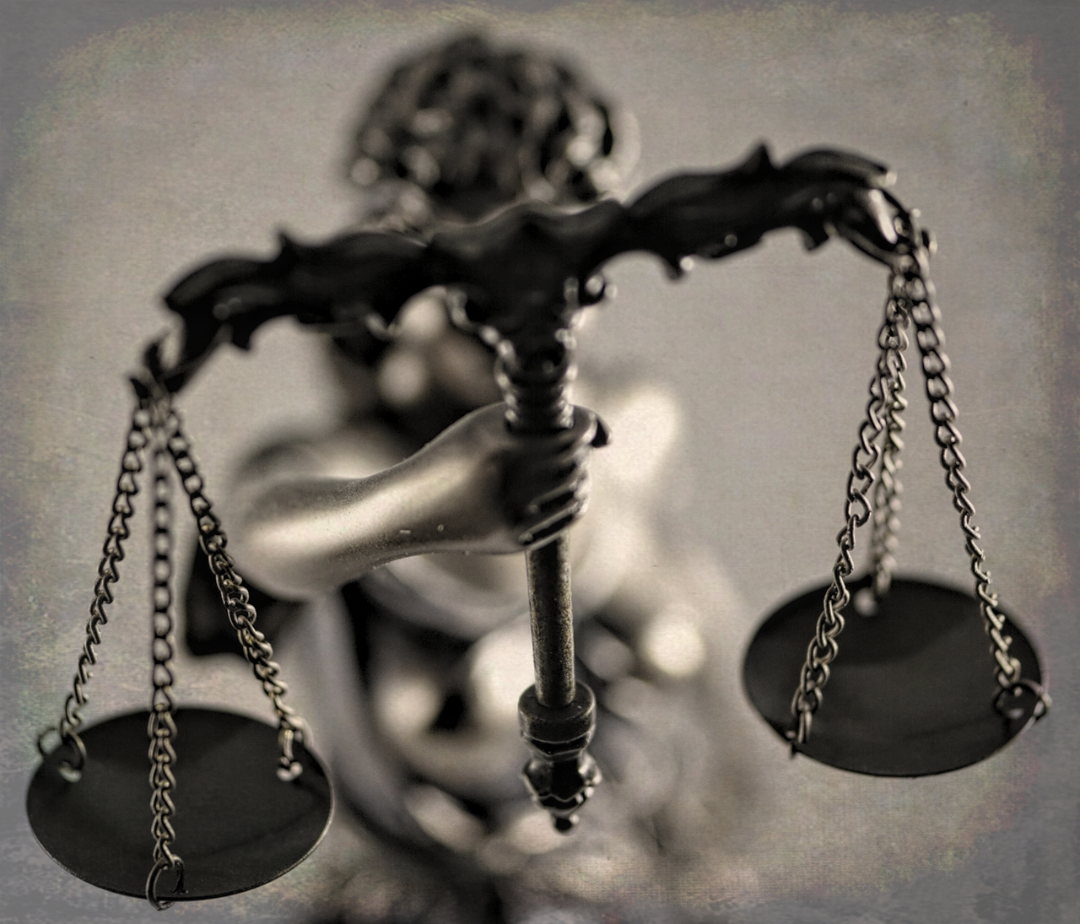
Fair Use
Purpose of use
Nature of work used
Amount and substantially of portion used
Effect of use on the market for the original work
Justice in the Balance by Jo Zimny Photos CC BY NC ND
Notes:
Of course, not all uses need to be licensed! We could talk for days about fair use, and I won’t delve deeply into it here. Please see Jill Cirasella’s presentation “Strong Words: The Surprising Power of “Such As” and “Include” in the Fair Use Clause” from Oct. 6. Post link to chat: https://copyrightconference.lib.miamioh.edu/schedule/
I’ll just mention these thoughts about fair use and online multimodal assignments:
1. It’s important for students to know law allows certain uses without permission. We need these allowances to engage in dialogue.
2. Uses for scholarship and comment are favored . . . But not a guaranty of fair use. Remember the other factors and context of use.
Transformative uses are favored! They tie to effect on market.
EXAMPLES help, e.g., Blanche v. Koons (transformed photographer Andrea Blanche’s fashion photos into a giant collage), Google Books (used book scans for a transformative purpose).
Climate change legislation video illustrates best practices: attribution, limited portions, recontextualized footage, added narration, transformation from news coverage into remix commentary.
3. Fair use in a classroom context with limited distribution is not too worrisome. The more widely a project is shared, the more students need to think about it.
4. Special note about parodies: Choose targets wisely. Be clear that there’s no confusion that student project is affiliated with the target of their parody.
5. Special note about music and other entertainment industry content: Beware of bots!

Slide 21
Student Creators
Students in classroom at UIS by Jeremy Wilburn CC BY NC ND.
Notes:
POLL 4: How often do you speak with students about managing their rights to the content they create?
Many of the examples we looked at earlier include little or no third-party content. Most of the content in them was created entirely by students! Thinking of students as creators instead of--or in addition to--being content users might force us to shift our approach a bit when we talk about © issues.

Slide 22
Quick Teaching Points for Student Authors
Copyright requires originality, a modicum of creativity, and fixation.
Copyright protection is automatic.
Copyright is a bundle of exclusive rights.
Notes:
Some of the same teaching points: requirements (easily fulfilled!) and the exclusive rights.
Students are often surprised to learn how easy it is to own a ©. They just have to create something original to them with a modicum of creativity that is fixed in a tangible medium of expression. No need to comply with formalities such as registration or notice. No fees.
And they have a bundle of exclusive rights to manage!

Slide 23
Copyright Ownership
A “joint work” is a work prepared by two or more authors with the intention that their contributions be merged into inseparable or interdependent parts of a unitary whole. 17 U.S.C. §101
Each author’s work must be independently copyrightable.
Joint authorship affects alienation and duration.
Protection in compilations extends to the selection and arrangement of works included.
See Ana Enriquez’s presentation about works for hire on Sept. 15, 2020.
Notes:
Since many multimodal assignments are group projects, it’s important to discuss ownership. For example, some UWT students believed their instructor would own © to their work for a class project. Not so!
© Ownership has real implications.
Control of 6 exclusive rights
Reputation and prestige
Monetization.
Pay attention to joint works because so many assignments are collaborative. See legal definition.
Requirement that joint authors contribute independently copyright-able materials. See Almuhammad v. Lee, Thompson v. Larsen.
Each owner can “alienate” the work without permission from the other authors, but must account for profits/share profits with co-owners.
Remember that © lasts for 70 years following the death of the longest surviving author.
In compilations, the original selection and arrangement of existing works is protected, but © to the 3rd party works is owned by separate entities.
© ownership can be more complicated for works by faculty and students that could be considered works for hire. Please see Ana Enriquez’s excellent in-depth exploration of works for hire from Sept. 15 earlier in this series.
Post link to chat: https://copyrightconference.lib.miamioh.edu/schedule/
Implications for student collaborations and assignments
Edit-a-thons
Annotations of prior texts
Open book
A professor might want students to “own” rights after working on an online project, but the students’ contributions must meet a threshold for them to own a copyright and/or be a joint author.

Slide 24
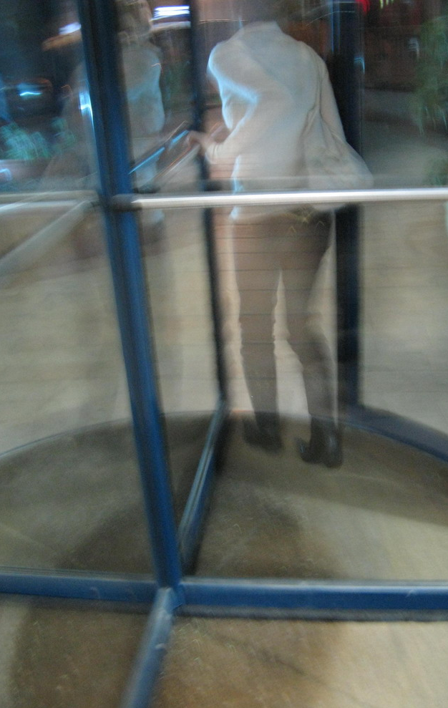
Student Responsibilities and Decisions
Apply a CC license? Which one?
Attribution
Distribution
Preservation
This photo by Dovi Shraga is licensed under CC BY NC.
Notes:
With ownership comes responsibility.
Who decides which CC license to assign to a class project?
• The instructor might decide for the class in consultation with you.
• You might explain the CC licenses to students and have them discuss and select one. One UW class decided to have a more restrictive license with an NC requirement because they didn’t want the advancement office to use their stories/work.
Attribution. The class that produced the women’s studies book collectively called themselves “UWB Zine Queens”
Put in chat: https://uw.pressbooks.pub/badasswomxninthepnw/
They also identified themselves by names throughout the book and in a special page at the end.
Put in chat: https://uw.pressbooks.pub/badasswomxninthepnw/back-matter/uwb-zine-queenz/
Students also should have the options not to attach their names to projects or not share their work publicly.

Slide 25
Student Privacy
The Family Educational Rights and Privacy Act (FERPA) applies to educational records. Instructors may comply with FERPA through:
FERPA waivers
Consent forms for sharing assignments online with desired attribution (See UW Bothell guide example)
Pseudonyms
MOUs allowing students to change their license or attribution at any point up to publication. (See Rebus Foundation example)
Large group projects could credit students who contributed without identifying that they were part of a specific course
Alternate assignments
Notes:
This brings us to student privacy and some other legal and legal-ish aspects of open, multimodal assignments.
FERPA applies to “educational records,” which are “records that are directly related to a student and that are maintained by an educational . . . institution or a party acting for or on behalf of the . . . institution.” They include but are not limited to “grades, transcripts, class lists, student course schedules” plus health, financial, and disciplinary records. ”The information may be recorded in any way, including, but not limited to, handwriting, print, computer media, videotape, audiotape, film, microfilm, microfiche, and e-mail.” 34 CFR § 99.2
Instructors may comply with FERPA through:
FERPA waivers
Consent forms for sharing assignments online with desired attribution Put into chat: https://guides.lib.uw.edu/bothell/openstudentwork/resources
Pseudonyms
MOUs allowing students to change their license or attribution at any point up to publication. Put into chat: https://press.rebus.community/makingopentextbookswithstudents/chapter/mou-for-students-faculty/
Large group projects could credit students who contributed without identifying that they were part of a specific course
Alternate assignments
One approach to prevent students from feeling coerced is to collect/read consent forms AFTER assignment completed and graded.
UW student in Critical Filipinx Studies did not provide consent to be identified online but appeared in group photo.

Slide 26
Platform Terms of Use
No defamation, malware, infringing content, etc.
What rights does each platform give itself to content posted?
What rights does platform give other users to the content posted?
Notes:
Terms of service

Slide 27
YouTube Terms (emphasis added)
[Y]ou must not submit to the Service any Content that does not comply with this Agreement . . . or the law. For example, the Content you submit must not include third-party intellectual property (such as copyrighted material) unless you have permission . . . or are otherwise legally entitled to do so. You are legally responsible for the Content you submit to the Service. We may use automated systems that analyze your Content to help detect infringement and abuse, such as spam, malware, and illegal content.
You grant to YouTube a worldwide, non-exclusive, royalty-free, sublicensable and transferable license to use that Content (including to reproduce, distribute, prepare derivative works, display and perform it) in connection with the Service and YouTube’s . . . business, including for the purpose of promoting . . . the Service.
You also grant each other user of the Service a worldwide, non-exclusive, royalty-free license to access your Content through the Service, and to use that Content, including to reproduce, distribute, prepare derivative works, display, and perform it, only as enabled by a feature of the Service (such as video playback or embeds). For clarity, this license does not grant any rights or permissions for a user to make use of your Content independent of the Service.
Notes:
Terms of service

Slide 28
Instagram Terms
Instagram "provide[s] the Instagram APIs to help broadcasters and publishers discover content, get digital rights to media, and share media using web embeds.”
"By accessing or using the Instagram website, the Instagram service, or any applications . . . made available by Instagram . . . you agree to be bound by these terms of use.”
Users "grant to Instagram a nonexclusive, fully paid and royalty-free, transferable, sublicensable, worldwide license to the Content that you post on or through [Instagram], subject to [Instagram's] Privacy Policy."
Notes:
Does this allow Instagram to sublicense photos posted by users?
The 2d circuit is looking at this problem. Sinclair v Ziff Davis. A few months ago, Mashable used a photographer’s photo without her permission in a story about female photographers. The photographer, Stephanie Sinclair, sued Mashable’s parent company, Ziff Davis, and argued that Mashable did not have a valid sublicense to use her work. The Court sided with Ziff Davis and dismissed the case.
[Instagram has since updated its policies.] BUT THERE’S MORE:
Judge reconsidered her dismissal. In her second opinion, she affirmed that photographer did give Instagram a license to her work that allows Instagram to sublicense her work to others. BUT it is not clear whether Instagram’s sublicense to Mashable is valid. A license must convey the licensor's "explicit consent" to use a copyrighted work. Does preamble do that? Stay tuned.
In truth, terms of use have not loomed large in my work (yet). But this is an aspect of sharing work that students may not have considered, and a reality of the world of platforms and social media. It’s a teaching moment. If you want to use a platform, you have to follow the platform’s rules.

Slide 29
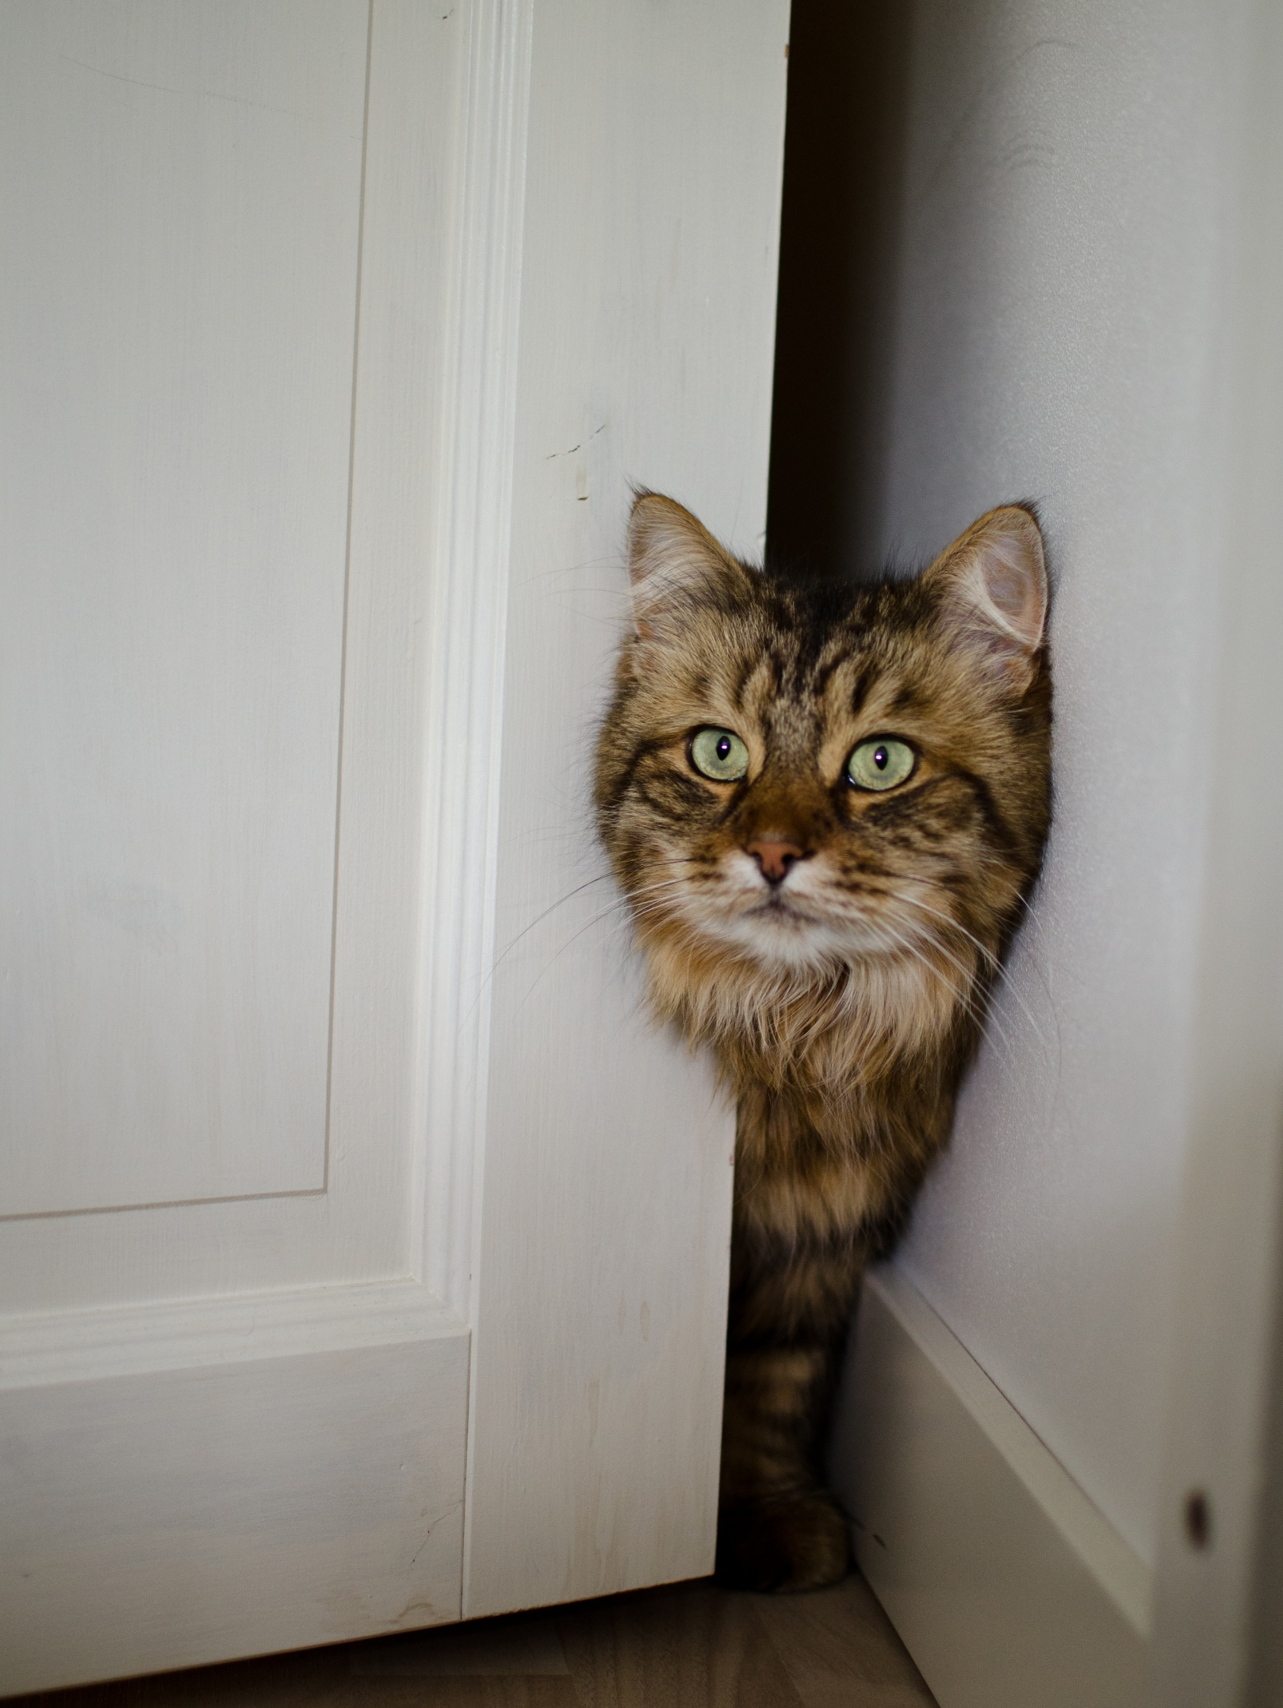
Added Considerations
Digital safety
Accessibility
Traditional cultural expression and knowledge
Personality rights
Parodies and satires
This photo by Patrik Stenstrom is licensed under CC BY.
Notes:
Here are some additional legal and ethical considerations that may arise with open, multimodal assignments. I just want to mention them briefly here.
-Related to the privacy slide, above, is students’ online presences. How are they identified, if at all? Who is collecting their data in the course of their online work?
Accessibility – good teaching moments for this, too, when working online
Traditional cultural expression and knowledge might enter in, e.g., Critical Filipinx Studies book. How do we treat knowledge and artefacts ethically in online projects? Worth speaking to students about, when relevant. I’m still looking for a good reading about this.
Personality rights are state law, about using someone’s likeness for commercial purposes and (at least in WA) fundraising. Seldom and issue but students may ask about using pictures of people.
Students like to make parodies and satires! Often a fair use discussion. Choose targets carefully. Make certain that it’s clear something is a parody. Bots may flag music.

Slide 30
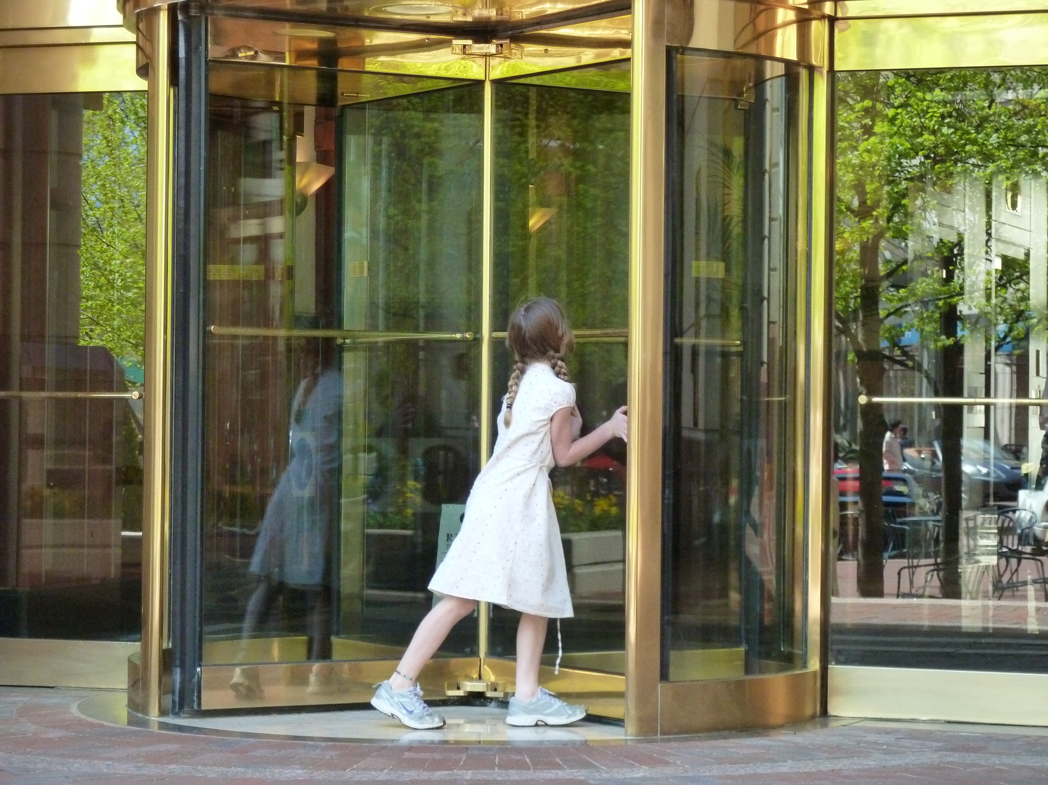
Your Roles
• Educator
• Consultant
• Team member and connector
• Liaison to General Counsel
• Advocate
Girl playing in revolving door by Adam Theo is licensed under CC BY NC.
Notes:
Online multimodal assignments engage students in new ways, bring in students who express themselves through modalities beyond the printed word. May be increasingly vital to remote teaching and learning.
Educator about © law, licenses, fair use, and related concerns
Consultant about © issues in assignments
Team member and connector to other services at your library (IR, teaching librarians, media specialists, etc.)
Liaison to General Counsel
Advocate for tools and services needed to support multimodal assignments

Slide 31
Summary
The value of multimodal assignments
Students as content users
The Creative Commons and other license types
Students as content creators
Copyright ownership
Student responsibilities and privacy
Platform terms of use
You!
Notes:
Here’s a summary of the major things we spent time on today.

Slide 32
Resources
• Creative Commons https://creativecommons.org/
• UW Bothell Guide to Open Student Work https://guides.lib.uw.edu/bothell/openstudentwork
• Open resources https://guides.lib.uw.edu/research/openresources
• Rebus Foundation (for OER) https://rebus.foundation/

Slide 33
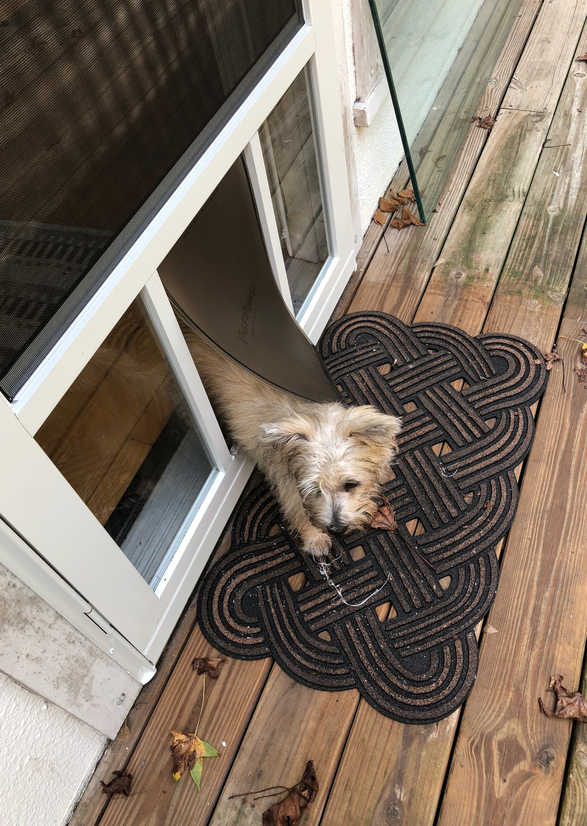
Special Thanks
Carla Myers, Miami University Libraries
Denise Hattwig, UW Bothell
Erika Bailey, UW Tacoma
Kathleen Collins, UW Seattle
All of the students, instructors, and librarians whose work was used in this presentation
Bella standing in the new dog door by moccasinlanding CC BY NC
Notes:
Special thanks to colleagues and students everywhere who are stepping out of the familiar classroom to experiment with open, multimodal assignments and learn together!

